Slide 1
SWaT Testbed

Slide 2
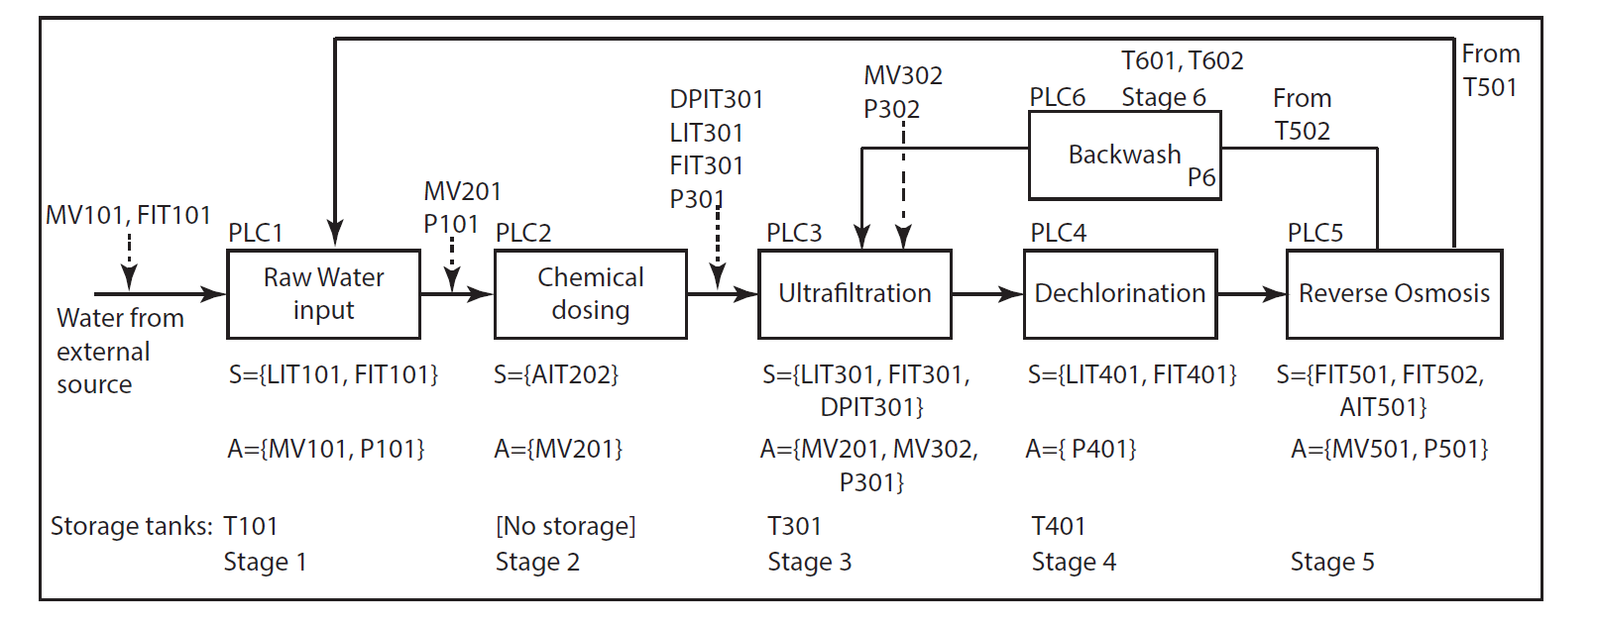
Level 0 refers to the communication layer between sensors, actuators and the PLC. Level 0 includes a Remote IO (RIO) device. The RIO is connected to the physical sensors and actuators. Monitoring and control information is exchanged between the PLC, sensors, and actuators across a Distributed Logical Router (DLR).
Level 1 refers to the communication layer among PLCs. This layer is implemented in a star topology and includes a SCADA workstation, an HMI, and a Historian.

Slide 3
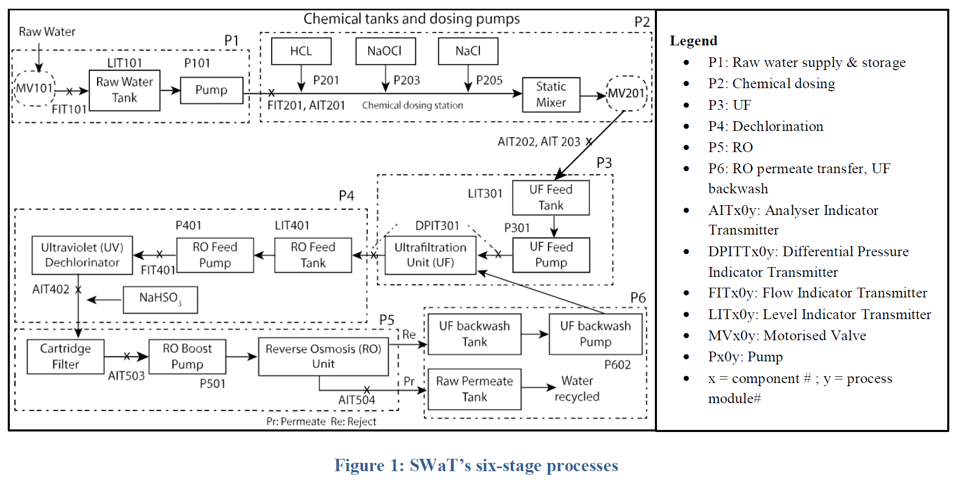
Differential pressure sensors in Stage 3 measure the pressure drop across the UF unit. A backwash cycle is initiated when the pressure drop exceeds 0.4 bar indicating that the membranes need immediate cleaning. 1 bar = 100 kPa

Slide 4
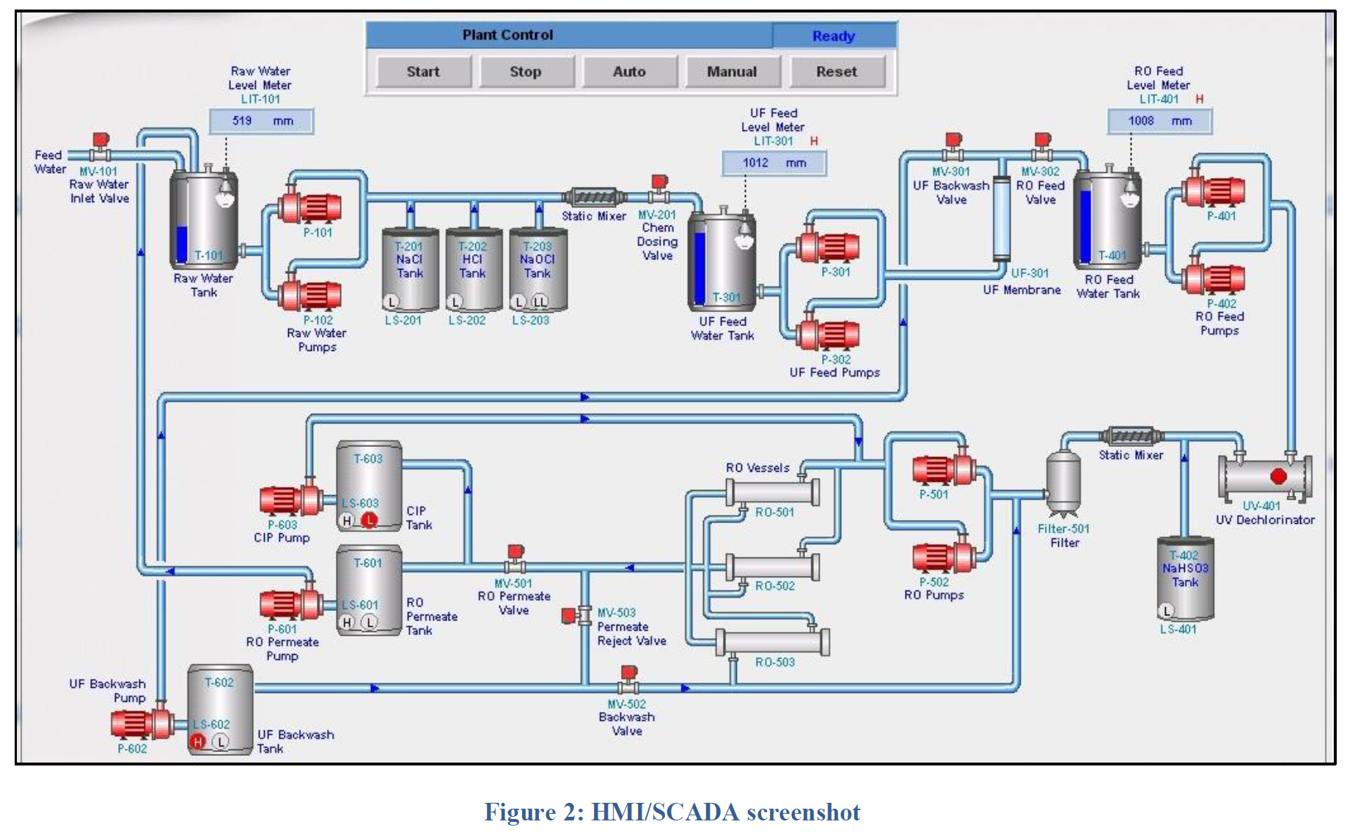
Each PLC obtains data from sensors associated with the corresponding stage, and controls pumps and valves in its domain.

Slide 5
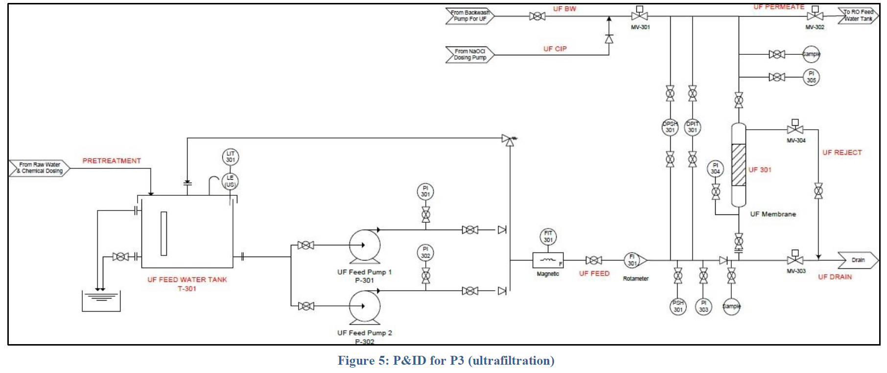
MV-302
MV-301
Level Indication Transmitter (mm):UF feed water tank level
Low,Low Low,High,and High High
DPSH-301
DPIH-301
MV-304
LIT301
P301
FIT301
P302
MV-303
PSH301

Slide 6
P301/ P302 | Pump water from UF feed water tank to RO feed water tank via UF filtration
MV-302
MV-301
Actuator
UF Feed Pump
DPSH-301
DPIH-301
MV-304
LIT301
P301
FIT301
P302
MV-303
PSH301

Slide 7
MV-302
MV-301
Flow Indication Transmitter
(m³/hr):flow in UF stage
DPSH-301
DPIH-301
MV-304
LIT301
P301
FIT301
P302
MV-303
PSH301

Slide 8
Differential Pressure Indicator Transmitter (kPa)
Control the back-wash process
MV-302
MV-301
DPSH-301
DPIH-301
MV-304
LIT301
P301
FIT301
P302
MV-303
PSH301

Slide 9
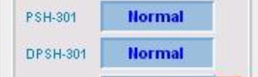
MV301 | Control UF-Backwash process
MV302 | Control water from UF process to De-Chlorination unit
MV303 | Control UF-Backwash drain
MV304 | Control UF drain
MV-302
MV-301
DPSH-301
DPIH-301
MV-304
LIT301
Actuators
Motorised Valve
P301
FIT301
P302
MV-303
PSH301

Slide 10
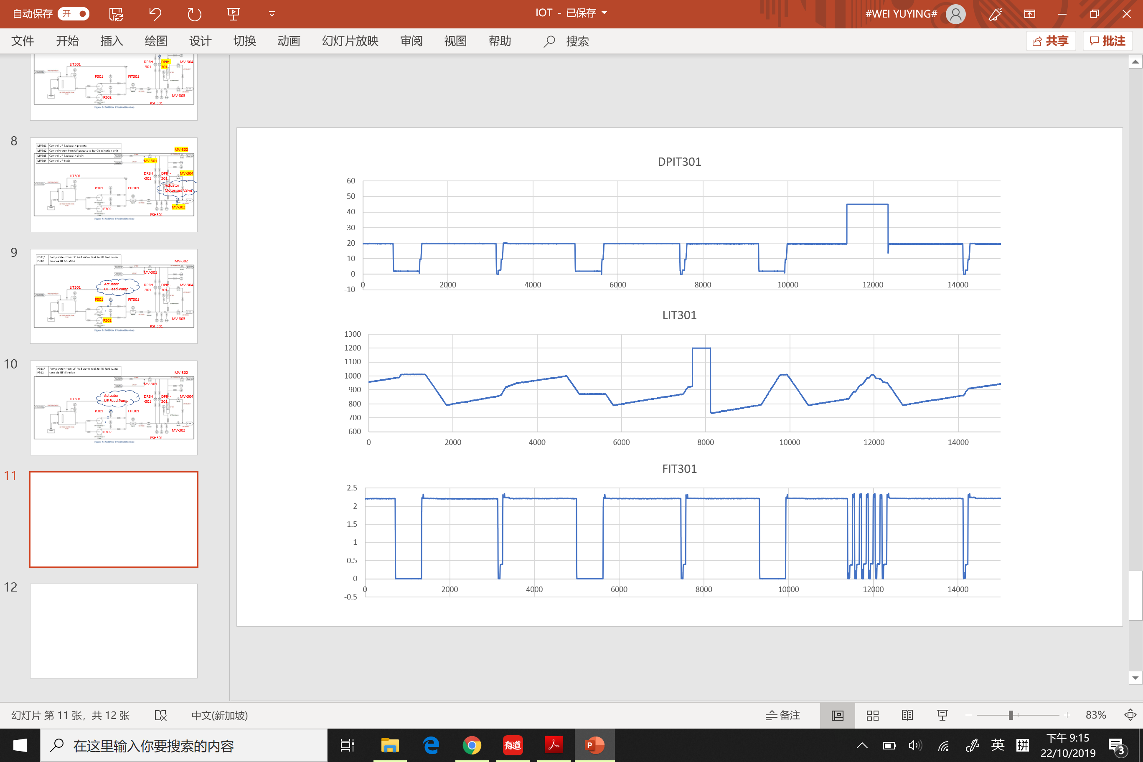
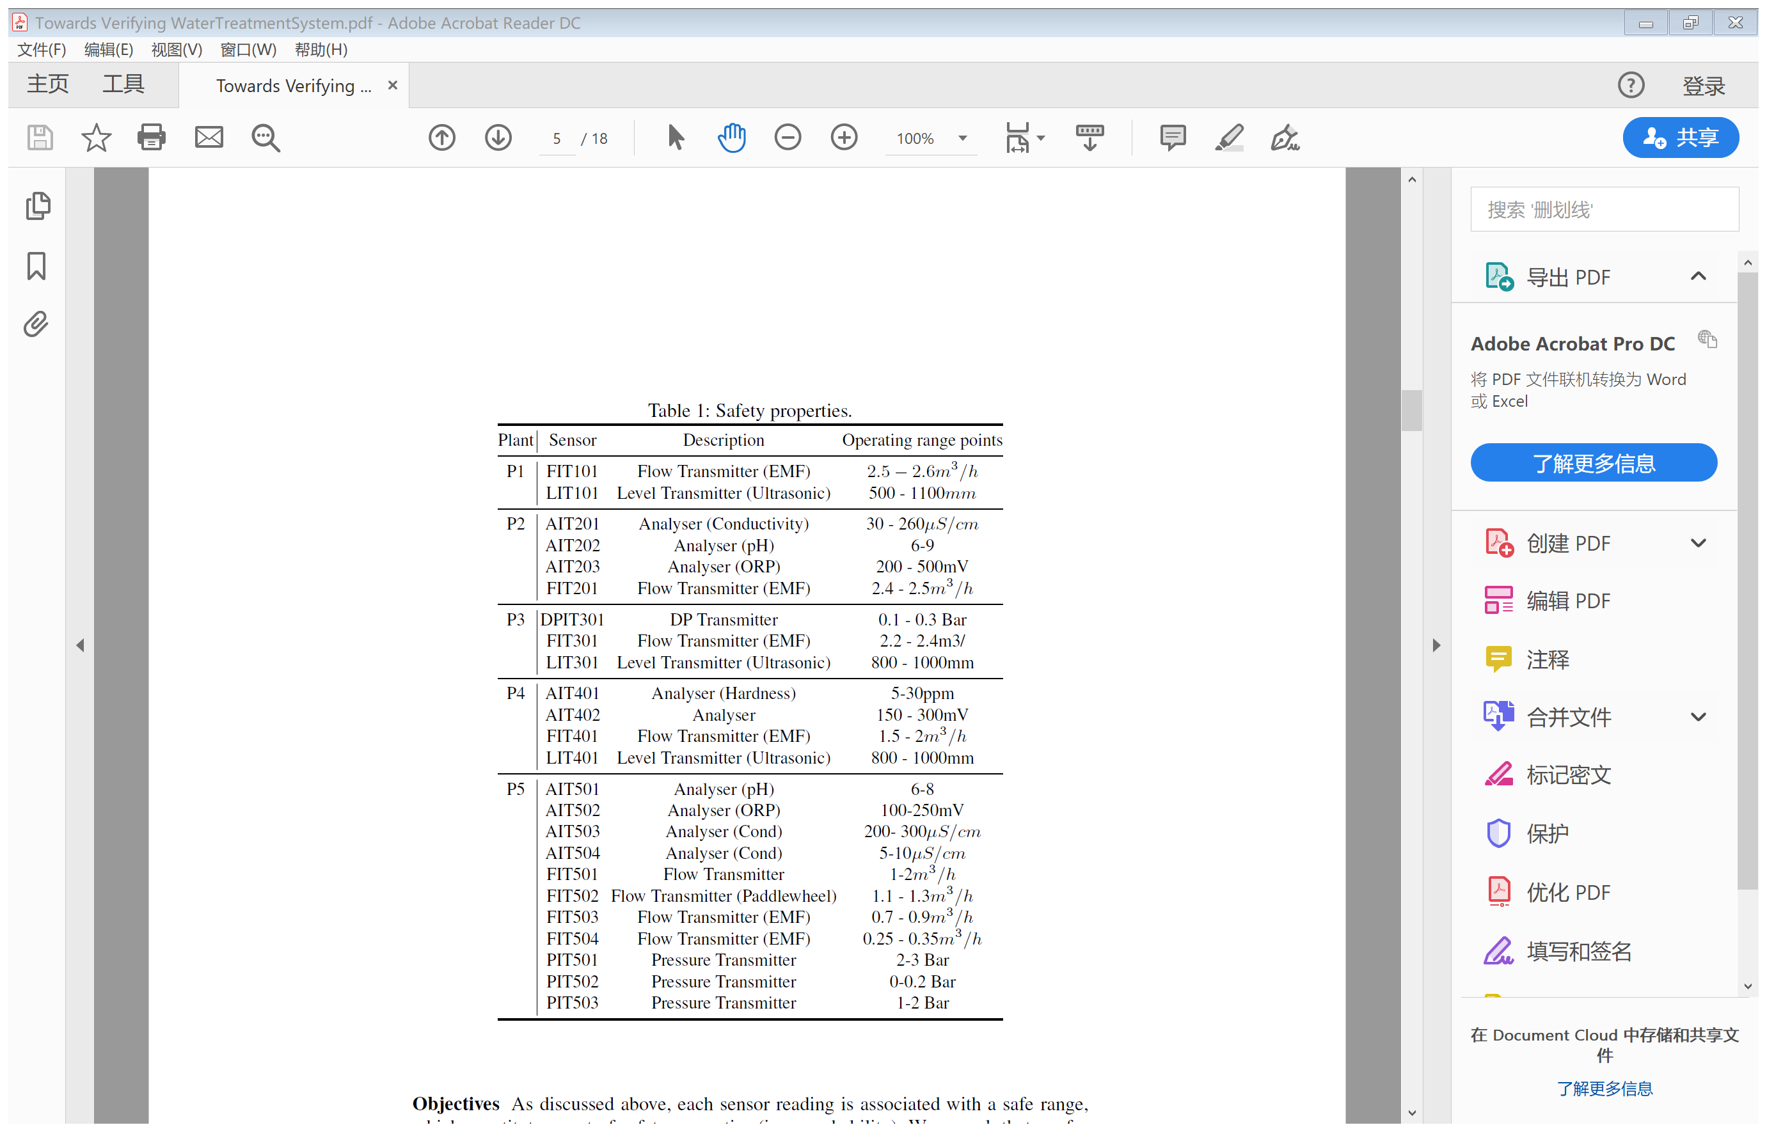

Slide 11
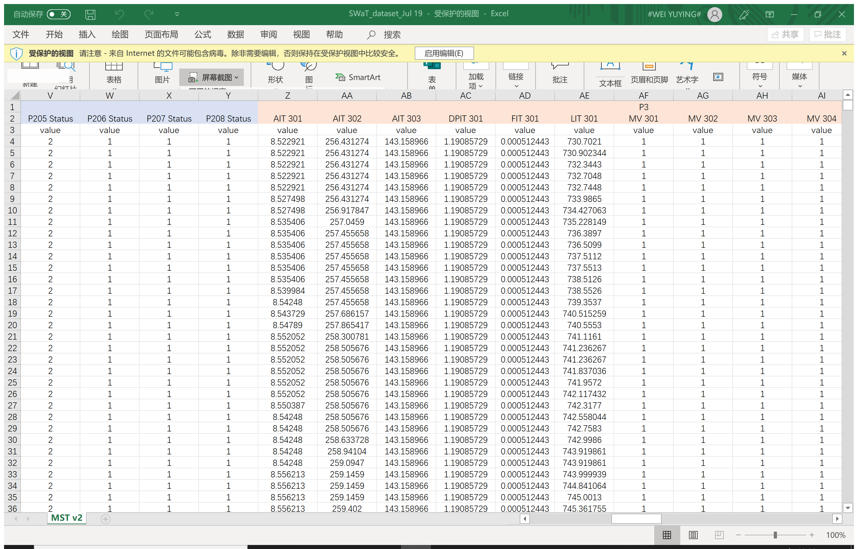
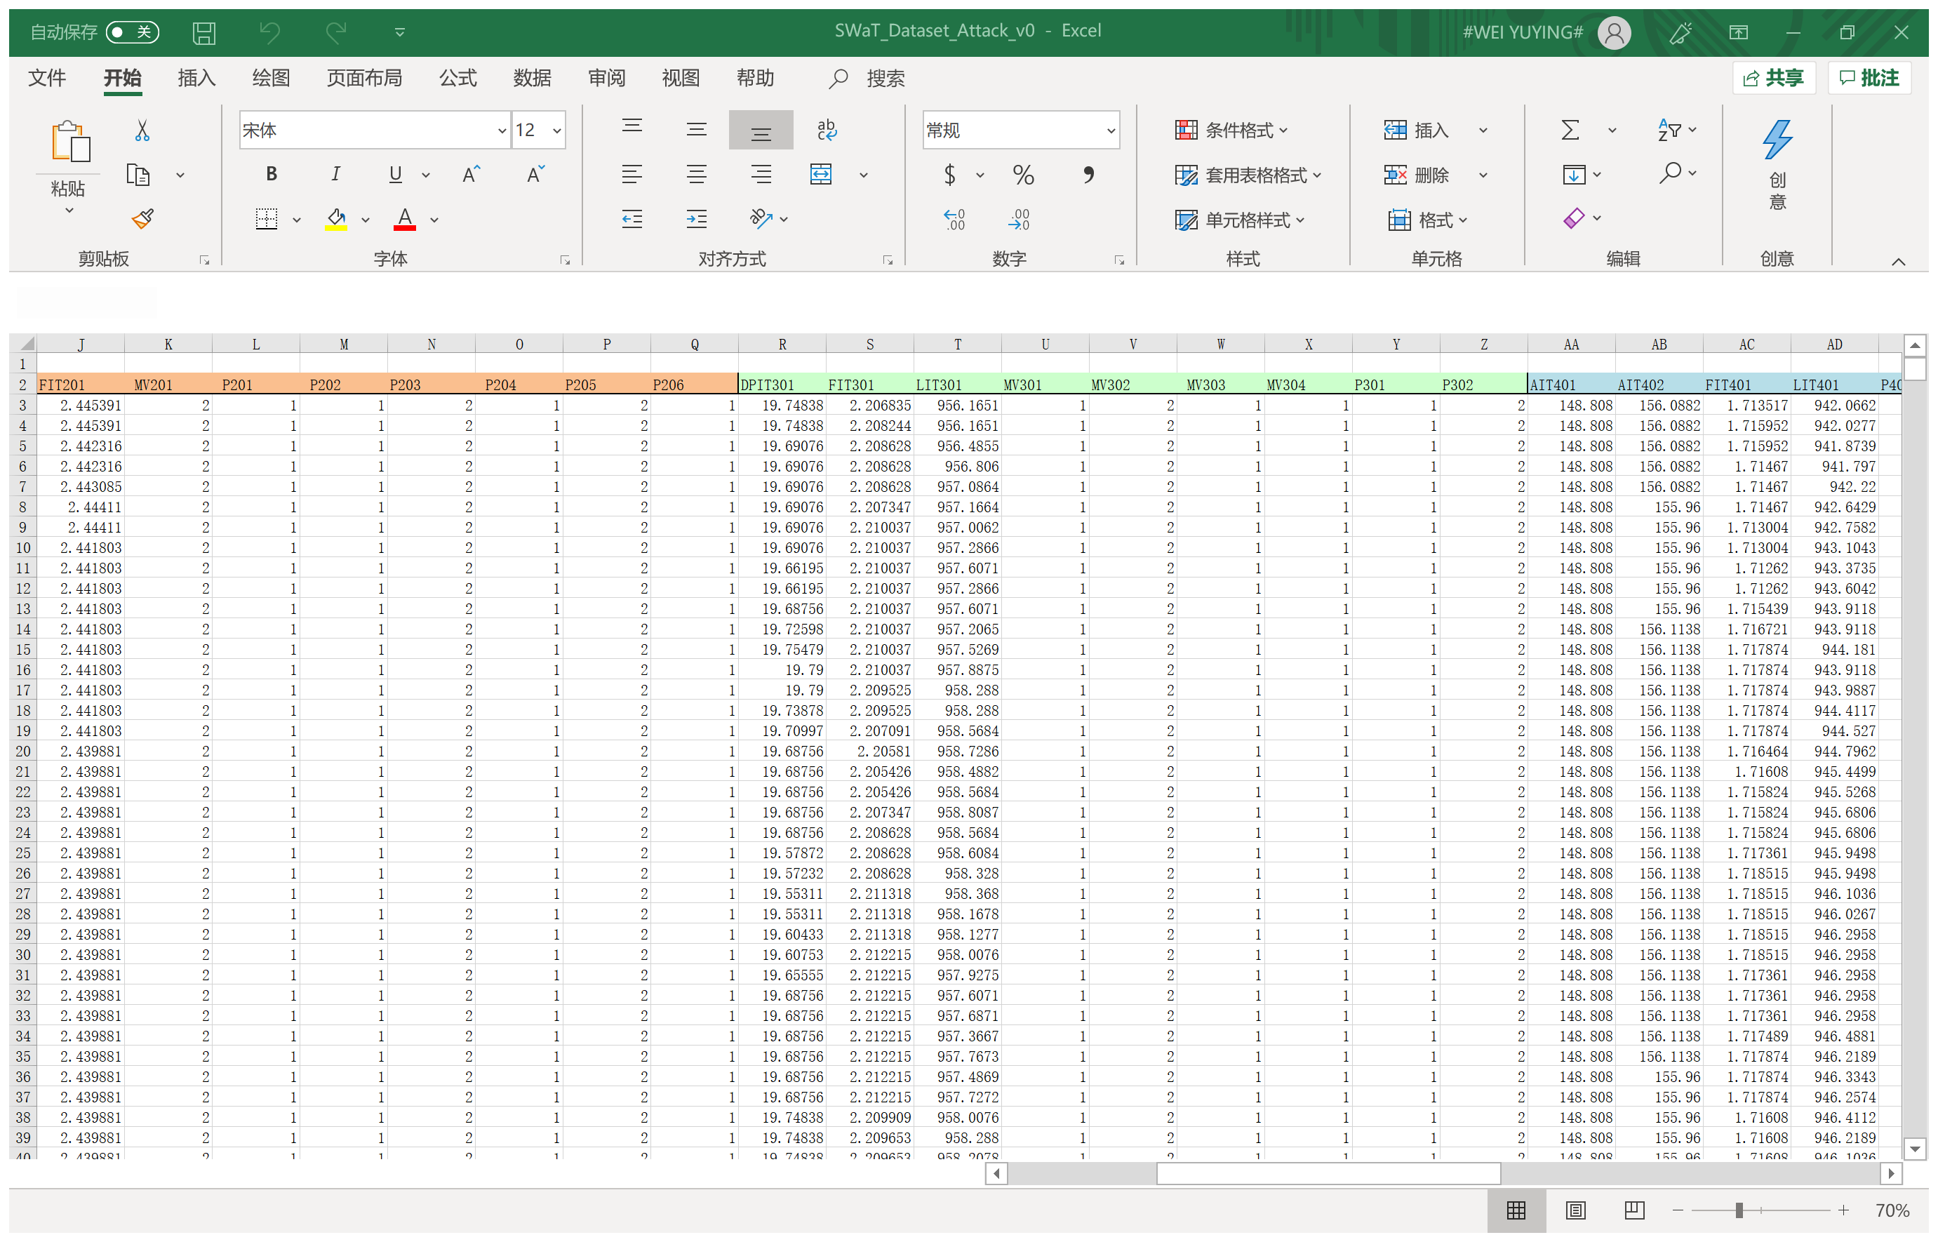
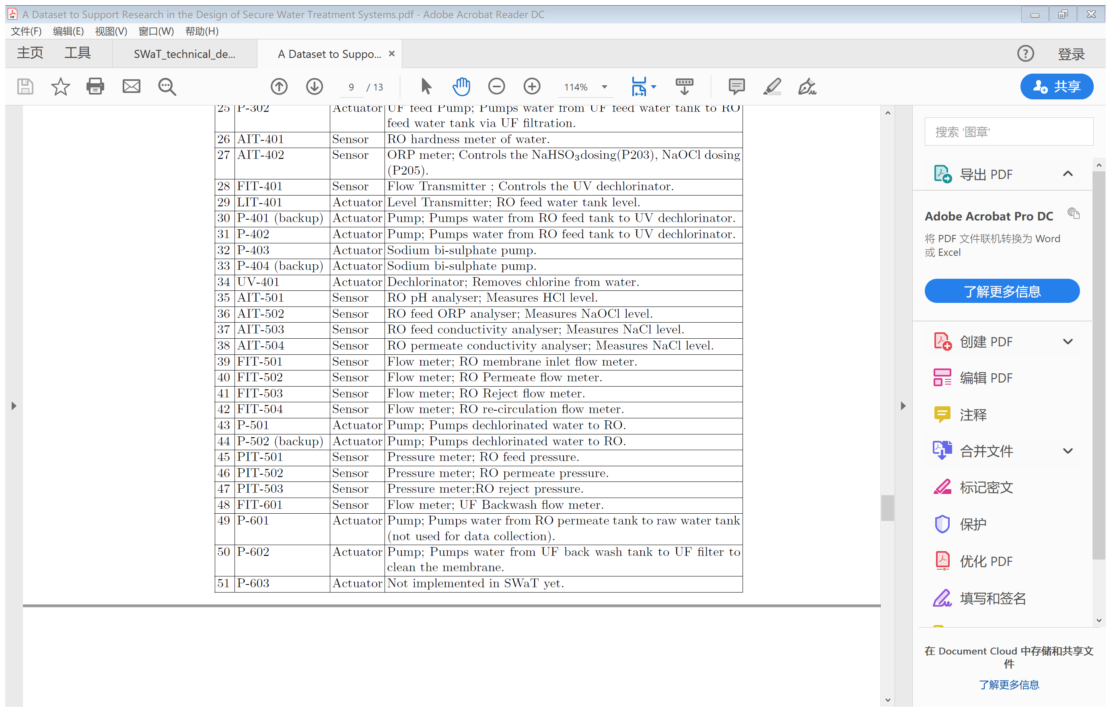

Slide 12
